Slide 1
DISADVANTAGES OF ICT

Slide 2
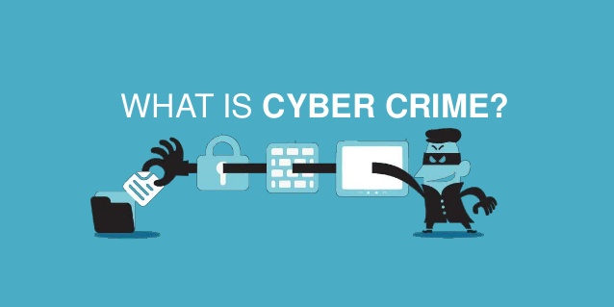
The Disadvantage of ICT
Cyber Crime
  - are illegal acts done through the use of the internet. People all over the world some of which the public doesn’t even known are capable of being done electronically.

Slide 3
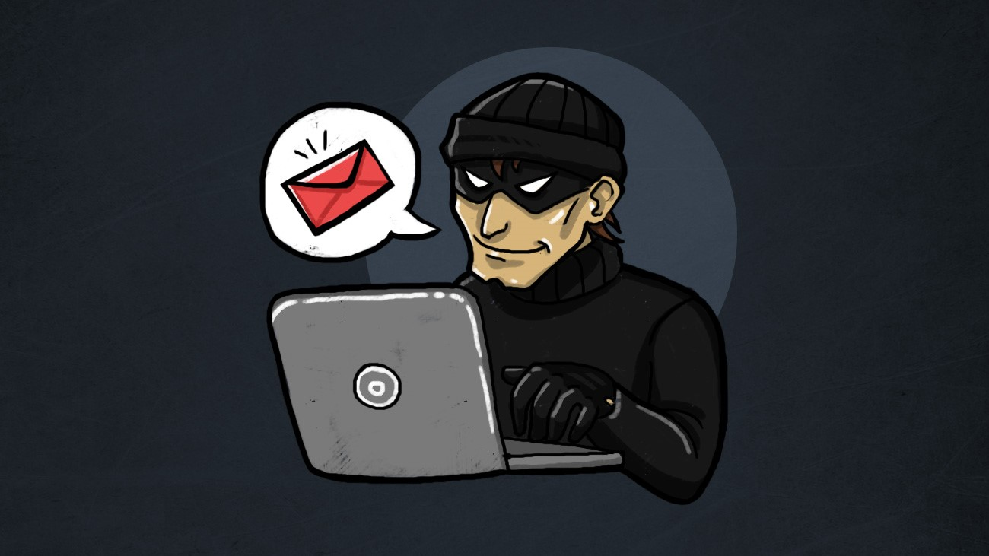
1. Phishing and Spoofing
  - Spoofing attack is when a malicious party impersonates another device or user on network in order to launch attack against network hosts, steal data, spread malware or bypass access control.
  -Phishing is the attempt to acquire sensitive information such as usernames, password, and credit card detail (and sometimes, indirectly ,money,) often for malicious reasons, by masquerading as a trustworthy entity in an electronic communication.

Slide 4
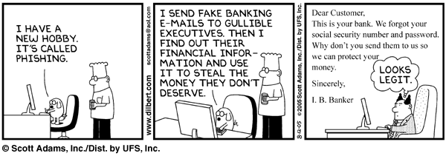
Difference Between Phishing and Spoofing
- The misconception that phishing and spoofing are synonymous, based on nothing more than aesthetic similarities, pervades the Internet. Phishing and spoofing are clearly different beneath the surface. One downloads malware to your computer or network, and the other tricks you into giving up sensitive financial information to a cyber crook. Phishing is a method of retrieval, while spoofing is a means of delivery.

Slide 5
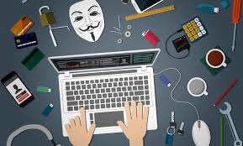
2. Blackmail/Extortion
-Extortion (also called blackmail, shakedown, out wresting, and exaction) is a criminal offence of unlawfully obtaining money, property, or services from a person, entity, or institution, through coercion. Refraining from doing harm is sometimes euphemistically called protection. Using the Internet to threaten to cause damage with the intent to extort from any person any money or other thing of value.

Slide 6

3. Accessing Stored Communications
-Accessing Stored Communications or hacking; Intentionally accessing, without authorization, a facility through which an electronic communication service is provided. The act of obtaining unauthorized access to data from computer network. This is typically done to commercial and government sites to threaten its owner. In late 2015, a group of Anonymous Philippines hacked the Twitter account of actress Maine Mendoza, who plays the famous character Yaya Dub of the popular AlDub tandem and posted links and messages on the account.

Slide 7
To prevent hackers:
1. Perform required software updates for your operating system and web browser.
2. Install a firewall on your computer.
3. Change your passwords often.
4. Purchase or download anti-virus software.
5. Install anti-spyware/adware programs onto your system.
6. Delete emails from unknown sources.

Slide 8
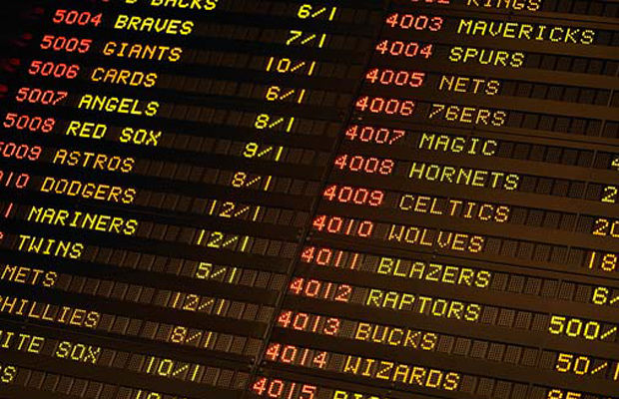
4. Sports Betting
-Sports Beating is engaging in the business of betting or wagering on any sporting event or contest over the Internet. In some countries, gambling (including sports betting) is illegal even if you are doing it over the Internet.

Slide 9

5. Non-Delivery of Merchandise
-Devising any scheme to defraud, or for obtaining money or property by means of false or fraudulent pretenses, or promises, and using the Internet for the purpose of executing the scheme. The non-delivery scam occurs when the scammer places an item up for sale when there is actually no item at all. The item is subsequently never delivered to the buyer after they purchase the item.

Slide 10
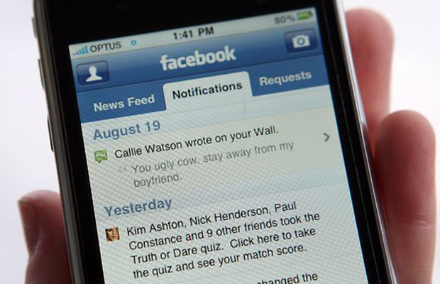
6. Electronic/ Cyber Harassment
-Cyber harassment refers to online harassment. Cyber harassment or bullying is the use of email, instant messaging, and derogatory websites to bully or otherwise harass an individual or group through personal attacks. Cyber harassment can be in the form of flames, comments made in chat rooms, sending of offensive or cruel e-mail, or even harassing others by posting on blogs or social networking sites. Cyber harassment is often difficult to track as the person responsible for the acts of cyber harassment remains anonymous while threatening others online. This usually applies to school-age children.

Slide 11
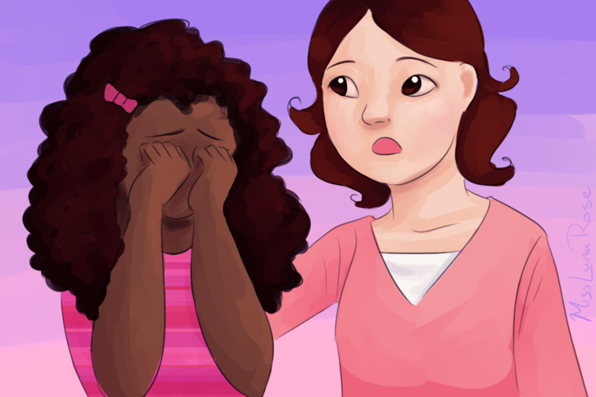
7. Child Pornography
-Using the Internet to transmit child pornography. Child pornography is distributed nowadays mainly through the Internet. Child pornography are produced not only on a professional scale by commercial providers, but also privately using victims from the producer’s own environment, from the exploitation of children by clients of child prostitutes. Child pornography is sold over commercial websites and also exchanged in closed groups or via peer-to-peer networks. Criminal groups also use the Internet to make big money selling child pornography.

Slide 12

8. Prostitution
-Persuading, inducing, enticing, or coercing any individual to travel in interstate commerce to engage in prostitution.The internet has become one of the preferred methods of communication for prostitution, as clients and prostitutes are less vulnerable to arrest or assault and for its convenience.

Slide 13
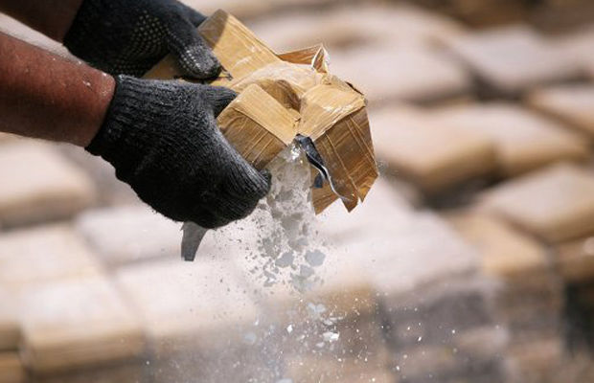
9. Drug Trafficking
-Delivering, distributing, or dispensing a controlled substance by means of the Internet. Darknet markets are used to buy and sell recreational drugs online. Some drug traffickers use encrypted messaging tools to communicate with drug mules. The dark web site Silk Road was a major online marketplace for drugs before it was shut down by law enforcement (then reopened under new management, and then shut down by law enforcement again).

Slide 14
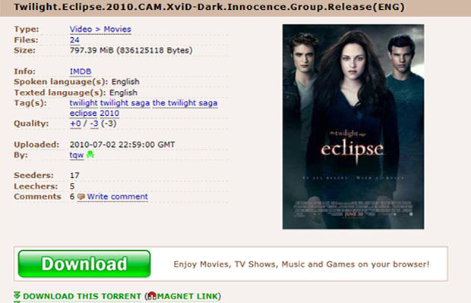
10. Criminal Copyright Infringement
-Criminal Copyright Infringement, the act of piracy mainly for financial gain. In late 2014, the number one pirate website, The PirateBay, was raided for the second time due to years of pirating movies, music, games, books, and other software. These kinds of websites earn money through advertising.

